Slide 1
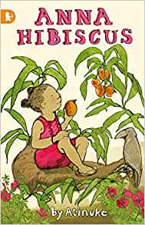
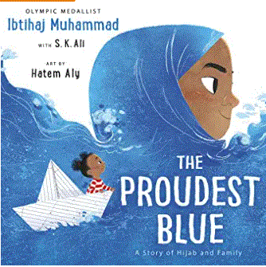
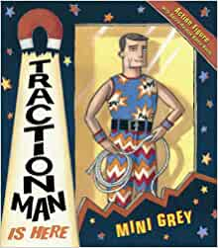
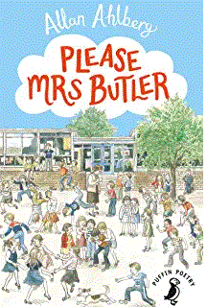
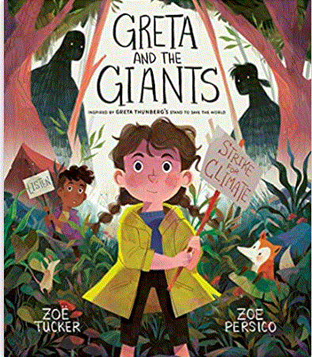
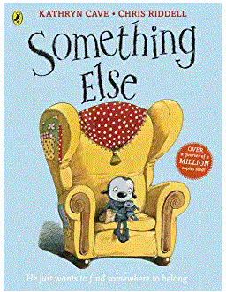
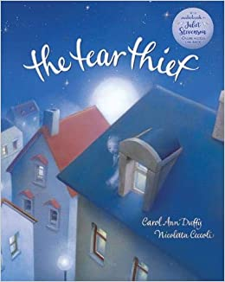
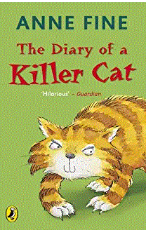
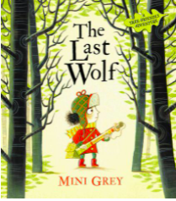
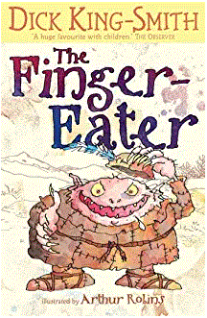
Zoe Tucker
Greta and the Giants
Something Else
Kathryn Cave
Traction Man
Mini Grey
Allan Ahlberg
Please Mrs Butler
Heard it in the playground
Ibtihay Muhammad
The Proudest Blue
Rapunzel
Bethan Woolivn
Atinuke
Anna Hibiscus
Mary Hoffman
Amazing Grace
Carol Anne Duffy
The Tear Thief
Ossiri and the
Bala Mengro
Year 2 Classroom Library Books
Name:
Voice in the park
Anthony Browne
Here I am
Patti Kim
Nick Sharratt
Mixed up fairy tales
Dick King Smith
The finger eater
Invisible boy
Trudy Ludwig
The day the crayons quit
Oliver Jeffers
Anne Fine
Diary of a killer cat, series
The Last Wolf
Mini Grey
The Egg
Mr P Robertson

